Slide 1
CARBON PRINT rOTEM wEIZMAN VU HA TONY FORMICA 23 april 20

Slide 2








CONTROL GROUPS MADE UP OF STATE-SPONSORED OUTLETS
AMERICA
RUSSIA
CHINA
CONTROL

Slide 3

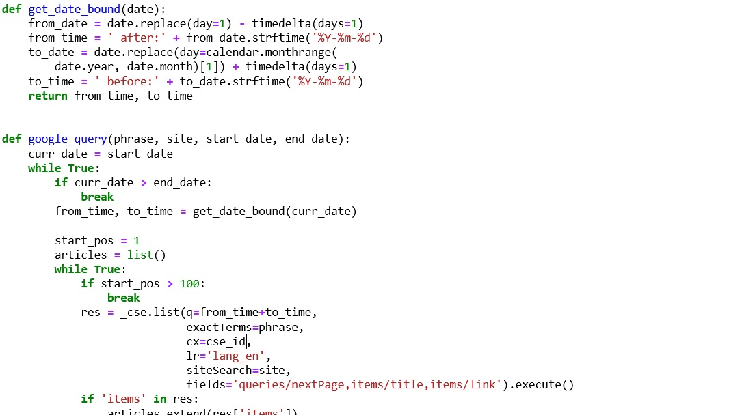
Getting the data
Method: cse.list
Parameters: keyword, domains, timeframe, no. of articles (n)
Script:
searches each website for articles published during specified timeframe, and contains specified keyword; and
randomly pulls n such articles per month from each website.

Slide 4
TOP 10 WORDS BY OUTLET
CONTROL
CHINA
AMERICA
RUSSIA

Slide 5
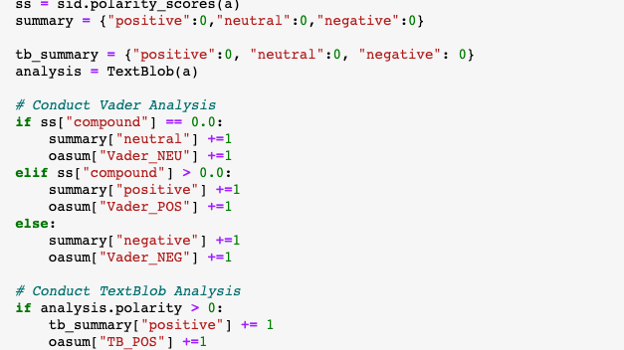
SENTIMENT ANALYSIS: VADER AND TEXTBLOB

Slide 6
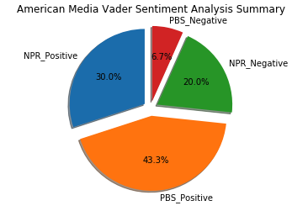
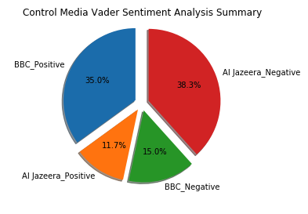
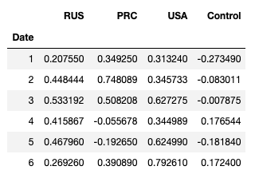
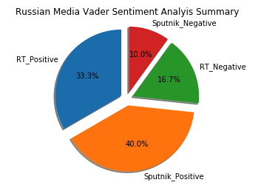
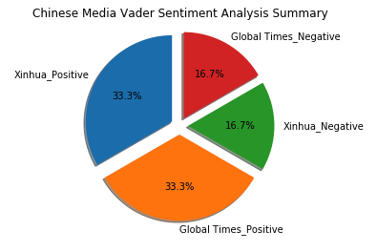

VADER SENTIMENT ANALYSIS BY OUTLET AND COUNTRY

Slide 7
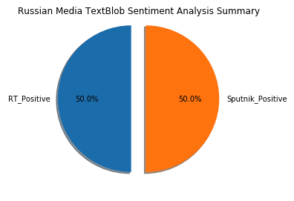
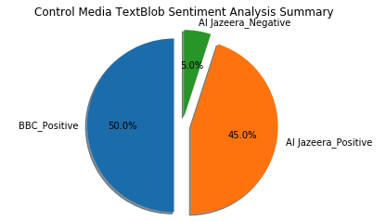
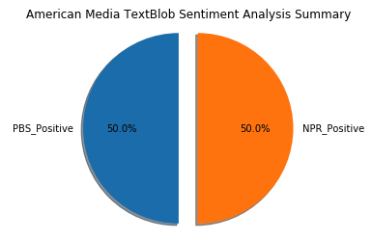
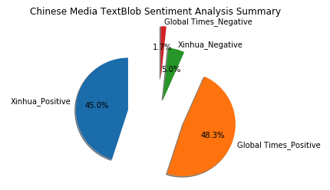
TEXTBLOB SENTIMENT ANALYSIS BY OUTLET, COUNTRY

Slide 8
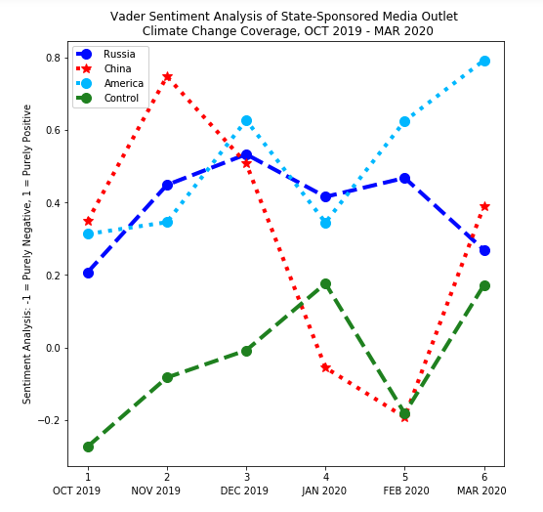
VADER ANALYSIS RESULTS

Slide 9
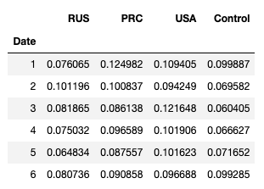
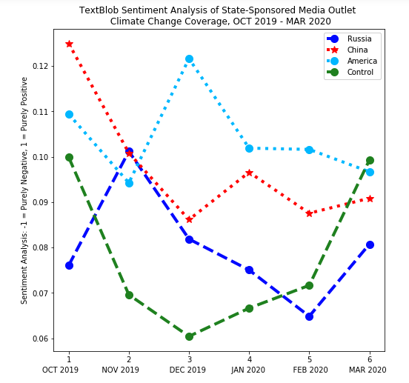
tEXTBLOB ANALYSIS RESULTS

Slide 10
CLIMATE CHANGE & other pol. issues
Slightly modified script:
searches each website for articles published during specified timeframe, and contains a list of keywords; and
randomly pulls N such articles per month from each website.
Pairs of issues:
climate change – U.S. election;
climate change – trade tariffs; and
climate change – sanctions

Slide 11
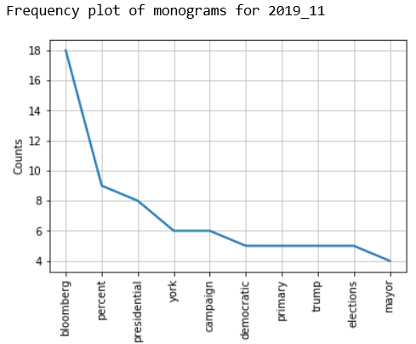
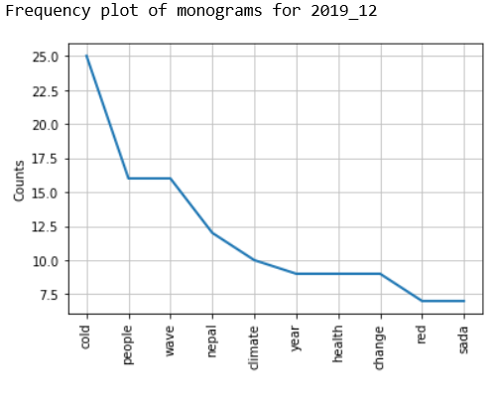
First stumbling block: data for China too limited
Two months of data for climate change – election pair:
For climate change – tariffs pair: only 1 – 2 articles/month

Slide 12
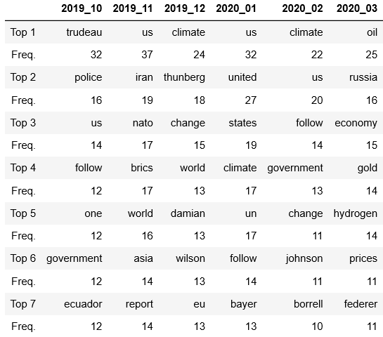
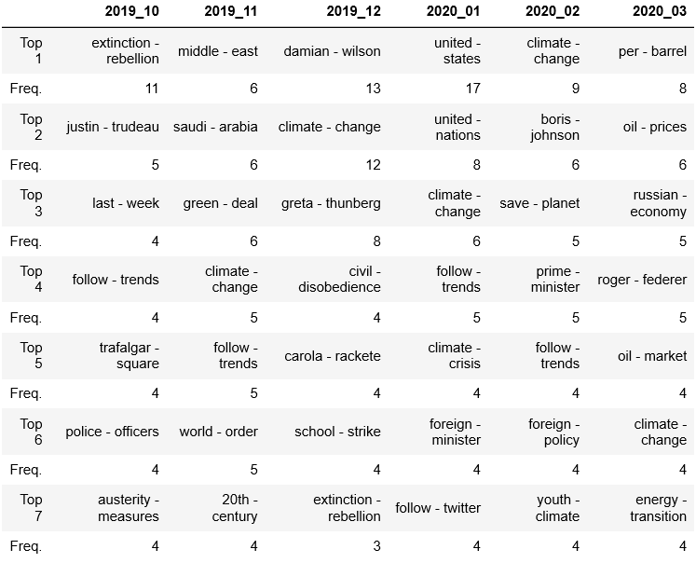
For Russia: data readily available
e.g. for climate change – U.S. sanctions pair:
Chinese papers better at compartmentalization?

Slide 13
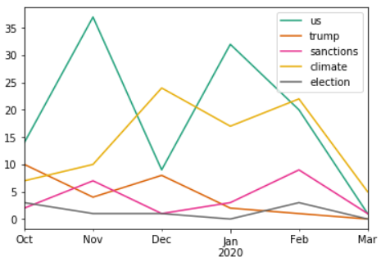
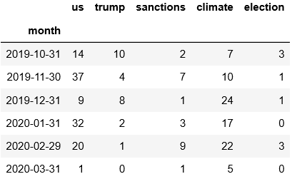
Word frequency over time?
No pattern in sight. 6-month timeframe apparently too short.

Slide 14
CONCLUSIONS AND WAY FORWARD
WHAT OUR DATA SUGGESTS NOW
IDENTIFIED METHODOLOGICAL ISSUES
WAY FORWARD

